Slide 1
Health and Safety Training
Competencies for Becoming a Family or Group Family Day Care Provider

Slide 2
Training Acknowledgement
This training is provided by the Professional Development Program through a contractual agreement between the NYS Office of Children and Family Services and The Research Foundation for the State University of New York at the University at Albany.

Slide 3
Welcome!
Colleen O’Grady
Manager, Department of Early Childhood Training
Professional Development Program
Joan Meyer
Principal Education Specialist
Professional Development Program

Slide 4
Program Updates
Hiring of PDP Trainer
PDP’s Health and Safety Support Team:
Colleen O’Grady, Kathleen Sanford, Ellen Schaefer
Regulations go into effect on May 1, 2014
Get in the Habit and Stay Tuned to OCFS Website http://ocfs.ny.gov/main/childcare/default.asp
Notes:
OCFS
Provider letter is expected soon
OCFS knows this is a time of transition for all and will continue to provide updates and share new forms on website

Slide 5
Program Updates
ECETP Health & Safety Trainer Website:
www.ecetp.pdp.albany.edu
Notes:
Click FOR TRAINERS AND ORGANIZATIONS (middle button bar)
Under “Health and Safety Trainers,” click first bullet: “Download important forms…”
Enter H&S PW: hsTR41N3r
OCFS
Provider letter is expected soon
OCFS knows this is a time of transition for all and will continue to provide updates and share new forms on website

Slide 6
Program Policy Reminders
Rosters MUST be submitted within five calendar days of course completion
The program’s primary caregiver must take H&S
Assistants and Substitutes are NOT required to take H&S
Course participants must make up any missed coursework within 60 days
Working email must be on file for all trainers
All trainers must train or fully participate in co-training the course at least twice per year.
Notes:
There has been confusion around WHO needs to take H&S. OCFS just clarified on the latest Q&A document that it is only the primary caregiver. Assistants and Subs are NOT required to take H&S (and never really were).
Fully participating in co-training means being present and supporting or training through the entire course.

Slide 7
Program Policy Changes
FDC/GFDC Provider Handbooks will no longer be used
All individuals taking this class must have a program application number, registration number, or license number, and it must be entered on the course roster.
Notes:
Some providers had referred to the Handbooks as the regulations, but ONLY THE REGULATIONS ARE THE REGULATIONS.

Slide 8
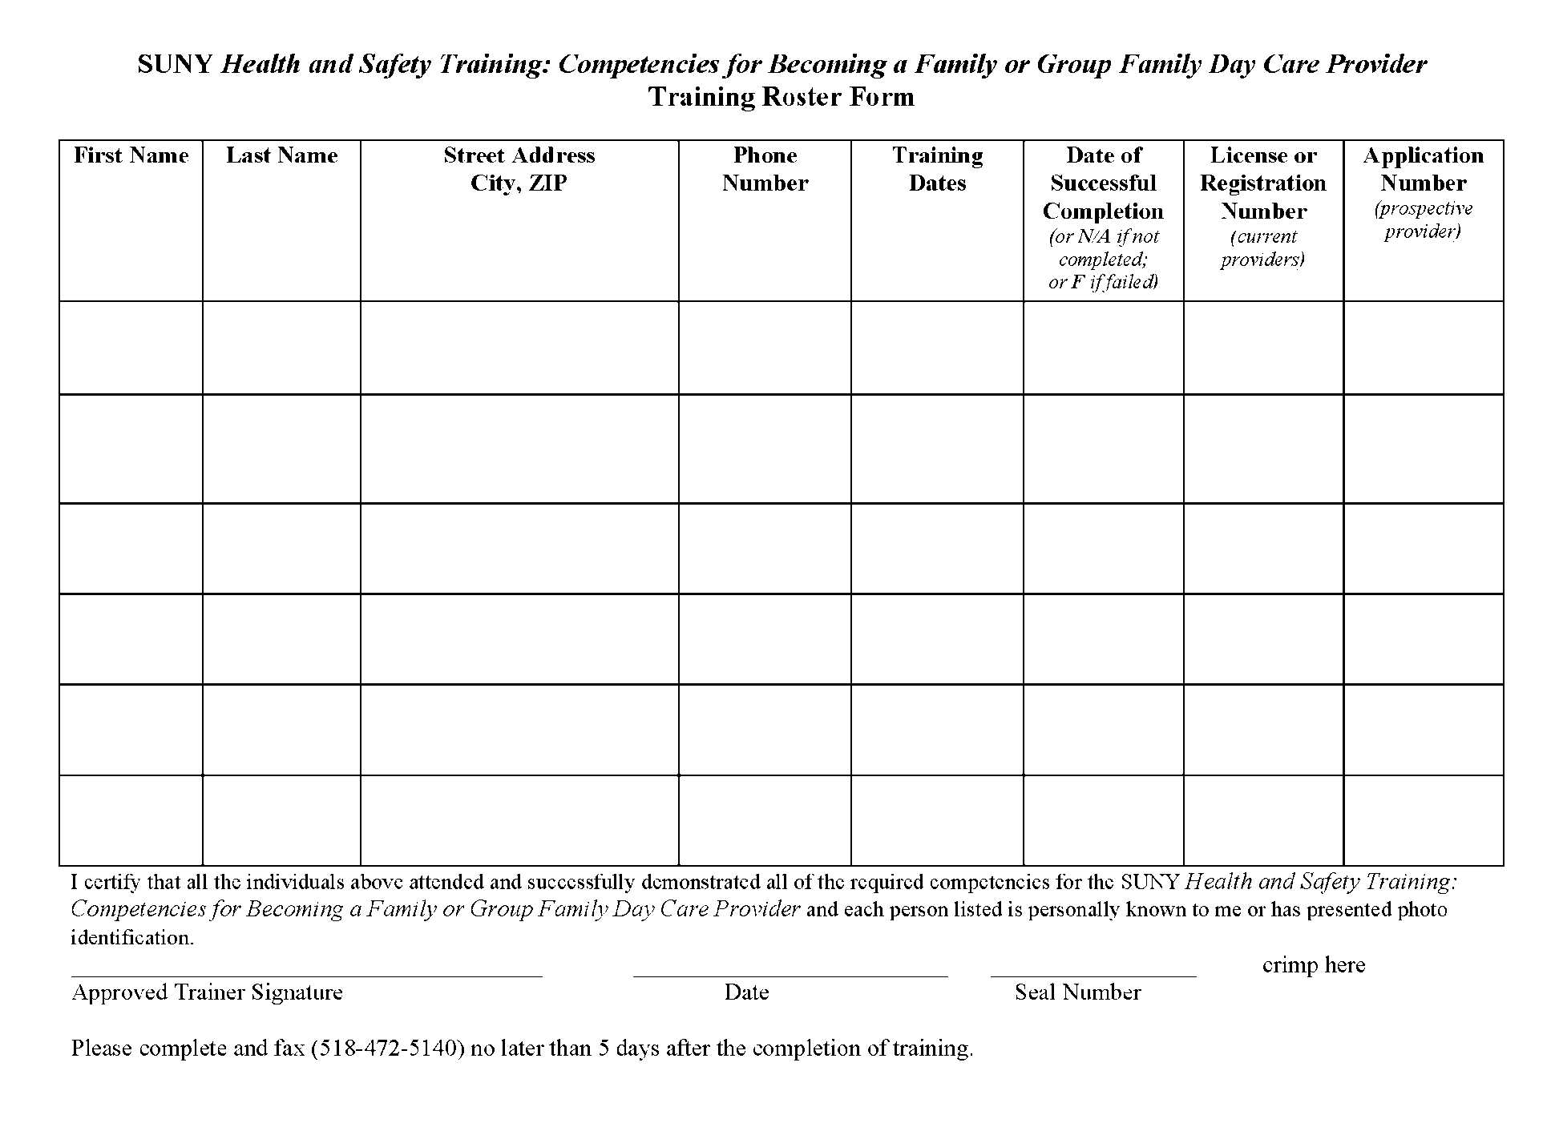
Notes:
Handbooks had been referred to as the regulations

Slide 9
Program Policy Changes
Applicants not licensed or registered within two years of completing the H&S course must repeat
[416/417.14(a)]
Before the Office issues an initial registration, the person who will be the provider
must complete a health and safety training course approved by the Office relating to the
protection of the health and safety of children and must demonstrate basic competency
with regard to health and safety standards. All health and safety training received after
the application for a registration has been submitted, but prior to issuance of the
registration, may be applied to the initial fifteen (15) hours of training required pursuant
to section [416/417].14(d) of this Part. Health and safety training must be successfully
completed once by an applicant or provider. If an applicant does not become licensed or
registered within two years of successfully completing the health and safety training, the
coursework must be repeated.

Slide 10
Focus on Teaching How to Use Regulations
Best Practice!!
Regulations
Regulations are the FLOOR of quality…the very LEAST we need to do!
Notes:
JOAN!!!
The regulations have always been the focus but we now have the opportunity to use them as the primary learning tool. (All references to Provider Handbooks have been removed; replaced with references to the regulations.)
YOU WILL NEED TO DOWNLOAD AND PRINT THE REGULATIONS FROM THE OCFS WEBSITE PRIOR TO YOUR CLASS!
Trainers should have mastery of the changes that impact Health and Safety at this point. The regs have been available for approximately four months.
Pages in curriculum that refers them to regs instead of provider handbooks

Slide 11
Important Links
http://ocfs.ny.gov/main/childcare/default.asp
http://ocfs.ny.gov/main/childcare/newregsvideo.asp
http://ocfs.ny.gov/main/childcare/assets/Family%20and%20Group%20Family%20Day%20Care%20Regulatory%20Questions%20and%20Answers.pdf
Notes:
1ST LINK: New Regs
2nd LINK: Video segments re new regs
3rd LINK: Q&A re new regs

Slide 12
Minor Video Changes
Notes:
Some videos were tweaked to remove unprotected surfaces and the microwaving plastic shot in food safety.
Flexibility continues to be present around Module 5 and Skipper’s story. The video continues to have a strong impact but if trainers have another video available from a reliable source, it may be substituted with prior approval from PDP.
Order of the videos has changed as a result of the addition of a new Module #4 Nutrition and Food Safety.

Slide 13
Reordering of Video Segments
Module 1: Your Primary Tool – The Regulations
#1 Introduction
Module 2: Creating a Safe Environment
#2 Indoor Safety
#3 Outdoor Safety
#4 What Is Competent, Direct Supervision?
Module 3: Creating a Healthy Environment
#5 Developing Health Care Policies and Procedures
#6 Developing Your Own Health Care Plan
#7 Day Care Registration and Child in Care Medical Statement
#8 Immunizations
#9 Lead Poisoning
#10 Conducting a Daily Health Check
#11 Administering Medication
#12 Planning for Emergencies
SEGMENT #’S CHANGE STARTING HERE:
Module 4: Nutrition and Food Safety
#13 Infant Feeding
#14 Food Safety
Module 5: Preventing Germ Transmission
#15 Germ Transmission
#16 Hand Washing
#17 Cleaning and Sanitizing
#18 Safety Precautions Relating to Blood
#19 Diaper Changing
Module 6: Protect and Prevent: Child Abuse and Maltreatment, Sudden Infant Death Syndrome (SIDS), and Shaken Baby Syndrome
#20 Your Role as a Mandated Reporter
#21 Child Abuse and Maltreatment Indicators
#22 Reasonable Cause to Suspect
#23 SIDS
#24 Shaken Baby Syndrome
Module 7: Emergency Preparation and Response
#25 Emergency Preparedness and Fire Safety
Notes:
Mention re Video #7: OCFS form name has CHANGED (after video was finalized) – it’s correct on this slide, but incorrect on video menu:
FROM – “Day Care Registration and Medical Statement of a Child in Care”
TO – “Day Care Registration and Child in Care Medical Statement”

Slide 14
New Health & Safety Curriculum

Slide 15
Curriculum Changes
Module 1 New Title: “Your Primary Tool, The Regulations”
Module 2: New “Safety Checklist”
Module 3: Narrowed Focus (Four Primary Steps)
New Module 4: “Nutrition and Food Safety”
Module 5: Preventing Germ Transmission
Module 6: Protect and Prevent
Module 7: Emergency Preparation: increased focus on “Sheltering in Place”
Healthy Environment
Step 1: Develop Program Policy
Step 2:
Prepare to Enroll Children
Step 3:
Put it into Action
Step 4:
Plan for Medical Emergencies
Notes:
Minor changes and clarifications made throughout. Not a major learning curve needed but all trainers should be putting the work in to learn what the changes are.
Module 1 title change to help put the focus on the Regs
Large Inspection Checklist replaced with a “safety checklist”
Four primary steps in Module 3 help narrow group focus.
New Module 4 – Stand alone Nutrition and Food Safety (pulled from old M6)
Modules 5, 6, 7 just shift forward – total of seven modules
More “sheltering in place” discussion in Module 7 [see pg 248 of NEW H&S trainer’s manual] Link takes you to ECETP eLearning catalog – Emergency Preparedness tng is 2nd item down

Slide 16
Primary Change…
Regulations
Regulations
Regulations
Focus on the Regulations...
Empower providers to use them as their primary business tool.
Notes:
Within each module there is a heavier focus on the regulations.

Slide 17
Questions?
Notes:
COLLEEN

Slide 18
Thank you!
Questions or comments about this training? Contact the Professional Development Program
518-443-5940
healthandsafety@albany.edu

